Slide 1
THE ENEMY
-Pearl Sydenstricker Buck

Slide 2

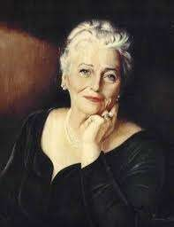
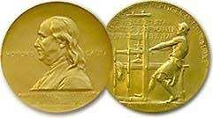
Pearl S Buck (1892-1973) Pulitzer Prize, Nobel Prize winner.
Believes in brotherhood & equality.

Slide 3
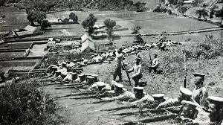
THEME
Humanism transcends
The story reveals the conflict between East and West

Slide 4
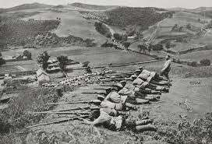
BACKGROUND
US and Japan war(1941)
Japanese were superior over americans

Slide 5
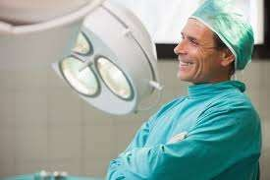
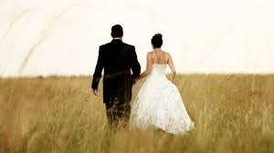
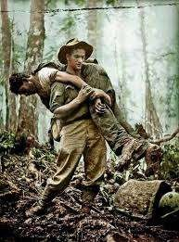
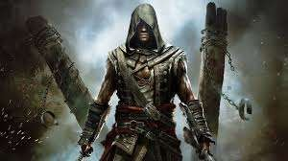
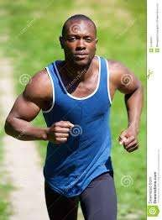


THE ENEMY

Slide 6
THE ENEMY
(BACKGROUND- US JAPAN WAR)
Dr. Sadao Hoki a Japanese of 22, studied surgery (America)
Marries Hana.
Encounters a man (Tom) near ocean (a man of 17 - US Navy)
Helps him (he is wounded)
Soon he recovers
Plans to kill Tom
Couldn't execute his plan
Tom recovers completely
Author decides to send him to a deserted island nearby
Reminds him of all americans

Slide 7
Summary
The scene of action is a spot on the Japanese coast. Dr Sadao Hoki’s house was a low, square stone built house. It was set upon rocks well above a narrow beach outlined with bent pines. Sadao’s father had a deep concern for his son’s education. So Sadao had been sent to America at twenty-two to learn all that could be learned of surgery and medicine there. He returned at thirty. He became famous not only as a surgeon but as a scientist also.
It was the time of the World War II. Japan was at war with America. Dr Sadao had not been sent abroad with the troops. The old General was under medical treatment and he might need an operation. So, Dr Sadao was being kept in Japan.

Slide 8
Sadao watched mists hide outlines of a little island near the shore. Then it came creeping up the beach below his house. His wife, Hana, came out and put her hand on his arm. It gave him pleasure. Then she laid her cheek against his arm.
At this moment, both of them saw something black come out of the mists. It was a man. He staggered a few steps. Then the curled mists hid him again. Hana and Sadao leaned over the railing of the veranda. They saw a man crawling on his hands and knees. Then he fell down on his face and lay there. They thought that it was perhaps a fisherman who had been washed from his boat.

Slide 9
When they came towards him, they saw that he was wounded. He lay motionless. They saw his face. Hana whispered that he was “a white man”. Sadao began to search for the wound. Blood flowed freshly at his touch. In order to stanch the fearful bleeding, he packed the wound with the sea moss. The man was unconscious. He moaned with pain in his stupor but he did not awaken.
Sadao muttered, “What shall we do with this man?” He said that the best thing that they could do was to put him back in the sea. Hana agreed with it. Sadao explained that it was a difficult situation. If they sheltered a white man in their house, they would be arrested. If they turned him over as a prisoner, he would certainly die. They were staring upon the inert figure with a curious repulsion.

Slide 10
Then they tried to find out what he was. He looked American. The battered cap had faint lettering “US Navy”. They concluded that he was a sailor from an American warship. The man was a prisoner of war. He had escaped and was wounded in the back.
Hana asked Sadao if they were able to put him back into the sea. Sadao hesitated. If the man had been whole, he could be turned over to the police without difficulty as he was his enemy. All Americans were his enemy. But since he was wounded they should not throw him back to the sea.
Hana observed that there was only one thing left to do. They must carry him into their house. Sadao was not sure about the reaction of the servants. Hana suggested that they must tell the servants that they intended to give him to the police. She said that they must do so, otherwise all of them would be in danger.

Slide 11
Together they lifted the man. He was very light. They carried him up the steps and into the side door of the passage. They carried him to an empty bedroom. Since the man was quite dirty, Sadao suggested that he had better be washed. If she fetched the water, he would wash the man. Hana could not bear him to touch the man. She offered to tell the maid Yumi. Sadao took the responsibility of informing others.
The pallor of the unconscious man’s face moved him first to stoop and feel his pulse. It was faint but it was there. He put his hand against the man’s cold breast. The heart too was yet alive. Sadao observed that he would die unless operated upon. The man was very young perhaps not even twenty-five. The man had to be washed first. However, the servants refused to do so. They did not want their master to heal the enemy.

Slide 12
Hana washed the man till his upper body was quite clean. Sadao put his instruments upon a sterilised towel. He began to wash the man’s back carefully. He asked Hana to give the anaesthetic if he needed it. Hana choked. She clapped her hands to her mouth and ran out of the room. He heard her retching in the garden. She had never seen an operation.
Sadao proceeded swiftly. Hana came in. Sadao asked her to saturate the cotton and hold it near his nostrils. She had to move it away a little when he breathed badly. Then Sadao got busy. He felt the tip of his instrument strike against something hard. It was just near his kidney. Then with the cleanest and most precise incision, the bullet was out. The man quivered, but he was still unconscious. Sadao gave him an injection and the man’s pulse grew stronger.

Slide 13
Hana had to serve the youngman herself, for none of the servants would enter the room. The man grew stronger day by day. The servants decided to quit if their master kept the enemy hidden there. On the seventh day, the servants left together. Hana carried the morning food to the prisoner. On coming back, she asked Sadao why they could not see clearly what they ought to do.
In the afternoon, a messenger came in official uniform. He asked Dr Sadao to come to the palace at once as the old General was in pain. Hana breathed a sigh of relief. When Sadao came to say good bye, she revealed her fear. She had thought that they had come to arrest him. Sadao promised to get rid of that man for her sake.

Slide 14
Sadao told the General about the man he had operated upon. The General acknowledged why Sadao was indispensable to him. The General promised to send his private assassins to kill the man and remove his body. He asked Sadao to leave the outer partition of the white man’s room to the garden open while he slept.
Sadao went home, thinking over the plan. He would tell Hana nothing. He was surprised to see the young American out of bed and preparing to go into the garden. He complained that the muscles on one side felt stiff. Dr Sadao said that exercise and massage will be helpful. He then asked Tom, the young American to go to bed. Sadao slept badly that night.
The next morning, Sadao went to the guest room and found him asleep. The second night also passed. The young man was still there. He had shaved himself. There was a faint colour in his cheeks.

Slide 15
Dr Sadao told him that he was quite well then. He offered to put his boat on the shore that night. It would have food and extra clothing in it. Tom might be able to row to that little island not far from the coast. It had not been fortified. Nobody lived there as it was submerged in storm. Since it was not the season of storm, he could live there till he saw a Korean fishing boat pass by.
As soon as it was dark, Sadao made preparations to help the young man escape. He gave him his flashlight. He asked him to give him two flashes as the sun set in case his food ran out. In case he was still there and all right, he was to signal him only one. He was warned not to signal in darkness, for it would be seen. The prisoner was now dressed in Japanese clothes. A black cloth was wrapped round his blond head. He found the way to the boat. Sadao waited till he saw one flash from the shore.
Dr Sadao had been called in the night to perform an emergency operation on the General. It involved his gall bladder. For twelve hours Sadao had not been sure the General would live. Then he began to breathe deeply again and to demand for food. Sadao had not been able to ask about the assassins. So far as he knew they had never come. The servants had returned. The room was cleaned.

Slide 16
One week after the operation, Sadao felt that the General was well enough to be spoken to about the prisoner. Sadao informed him that the prisoner had escaped. The General asked the doctor whether he had not promised to kill the man for the doctor. He then confessed the truth. He had been suffering a great deal.
So, he thought of nothing but himself. He had forgotten his promise. That night Sadao waited at dusk for the light from the island. There was none. His prisoner had gone away and was safe. Sadao wondered why he could not kill the young man though white people were repulsive.

Slide 17
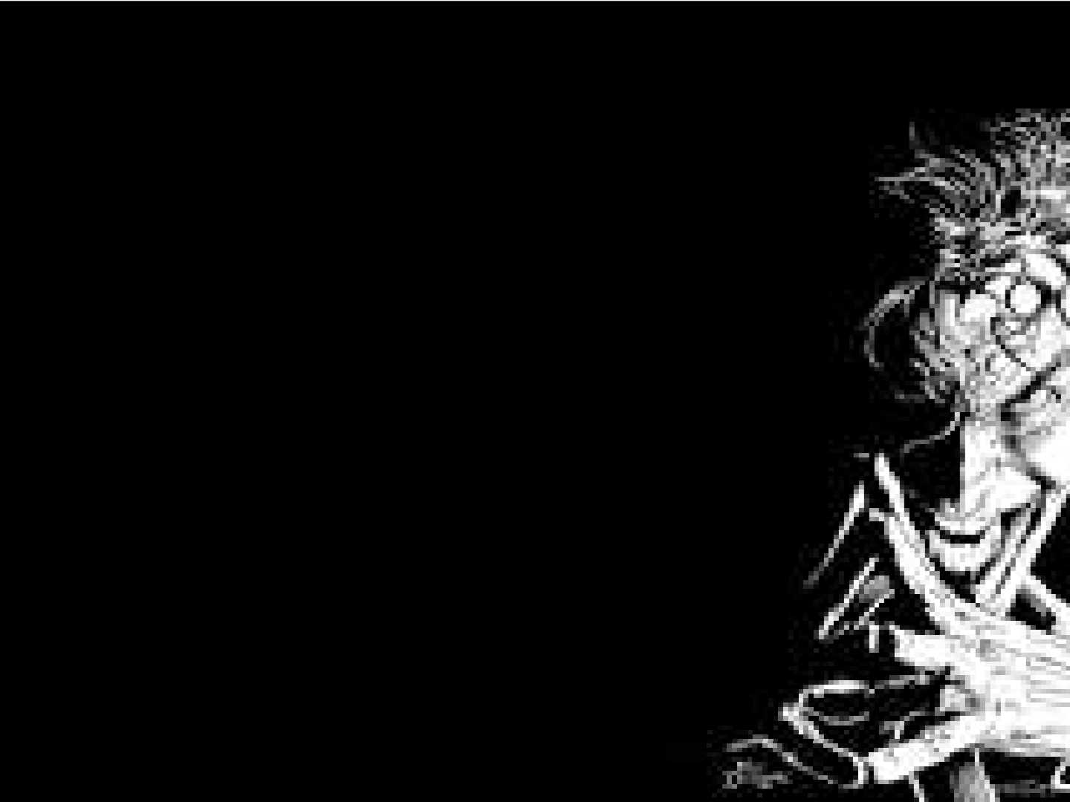
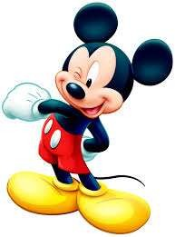
Thank you!!!

